Slide 1
Integrated motion control: a machine builder’s secret weapon expanded
Presented by Hack Summer and Ben Burke
December 2021

Slide 2
Presenters
Hack Summer
Mgr., Applications Engineering
HSummer@moog.com
Ben Burke
Applications Engineer
BBurke2@moog.com

Slide 3
Agenda
Introduction to Moog Animatics
Expanding SmartMotor Systems With Larger Axes up to 12 kW
Combitronic™ Technology
Key Markets and Applications

Slide 4
Objectives
Simplify your machine using an integrated motion control system.
Understand and make use of Combitronic™ technology.
Use the DS2020 Combitronic™ drive to add Moog CD motors, up to 12kW, to your SmartMotor™ system.

Slide 5
Introduction to Moog Animatics

Slide 6
History and Philosophy
Founded in 1987 as “Animatics”
Vision to be the first motion control provider to the automation market to provide true solutions instead of just motors
Inventor and first manufacturer of the fully integrated servo motor
Acquired by Moog in 2011

Slide 7
Making the Impossible Possible​ - How We Meet Our Customer’s Need
Deep Application Knowledge
Solutions based on mapping your needs
Long legacy in motion control products and power and data transmission products
Able to find best fit for your machine
Our
Customers
Support your success
Help you build machines that offer outstanding value
Ensure we add value from design to delivery to after sales service
Focus on Adding Value
Offer flexible, comprehensive and timely services
Help you transform from “break and fix” to planned maintenance
Deliver motion control expertise with products and services that meet your needs
Responsive Global Support

Slide 8
What is a SmartMotor™?
Servo motor (with optional brake)
Feedback (encoder)
Servo controller
Machine controller
Memory
Power amplifier
Logical I/O
Communications network
Fully integrated into a compact unit that’s easy to install and use.
SmartMotor™
Learn more!

Slide 9
Expanding SmartMotor Systems With Larger Axes up to 12 kW

Slide 10
Limit of SmartMotor Systems to Date
SmartMotor portfolio ended with 600W nominal continuous power
Larger axes required separate controller/motor system outside the SmartMotor Combitronic network.
How can we further simplify complex multi-axes solutions?
Idea to create a drive that seamlessly integrates larger axes into the SmartMotor systems.

Slide 11
Creation of the DS2020 Combitronic™ Drive
Enables addition of higher torque servos to existing SmartMotor systems to address the power needs for large axes of motion
Leverages the advantages of SmartMotor technology by being easily controlled by any SmartMotor on the same network
Used in conjunction with other SmartMotors
Compact, simplified machine
Learn more!

Slide 12
Benefits of the Combitronic™ Drive
Expands the standard drive’s capabilities by allowing it to act as a follower device on the SmartMotor™ Combitronic network
Easily controlled by any SmartMotor
Combitronic technology is standard
Significant space saving during installation
Personalized functionalities and flexible configurations
Quick, precise movements
Cooling options: natural or fan cooling
Integral holding brakes

Slide 13
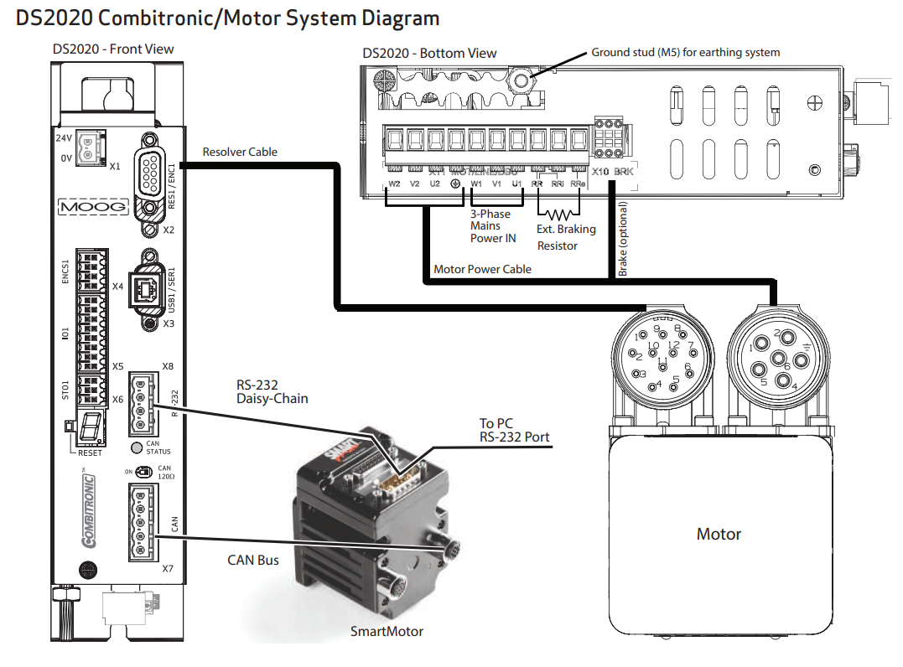
Integration with the SmartMotor
Works seamlessly in your SmartMotor-based machines and applications
Allows use of SMI software and AniBasic programming language to configure and program the entire system

Slide 14
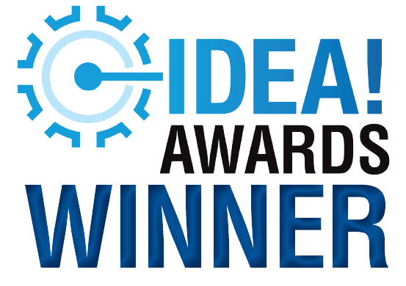
Award Winning
Winner in the 2021 IDEA! Awards (Motors & Drives category)
Presented by Machine Design and Hydraulics & Pneumatics
Highlights new technological developments on the market
Voted on by engineers and design professionals

Slide 15
Combitronic™ Technology

Slide 16
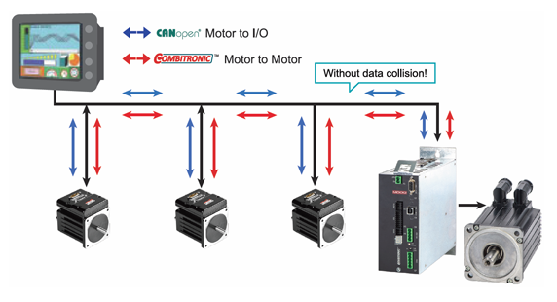
How Does Combitronic™ Work?
Each SmartMotor™ is fully programmable and capable of being a controller to multiple SmartMotors on the network
Not just through a few outgoing commands, I/O handshaking or value assignments
It is fully functional, bi-directional communications
Through a CAN bus, it resides on top of either the CANopen or DeviceNet protocol

Slide 17
How Does Combitronic™ Work? (cont’d)
Other than matching baud rates and ensuring unique node addresses, there are no other requirements
In a traditional network, all commands local to a SmartMotor controller are for the motor only
With Combitronic technology, those same commands can be applied to and reference other motors on the same network as if all the motors were being controlled by a central, multi-axis controller
Combitronic protocol is not register or data-packet based – it simply uses the typical local commands amended with a colon and target node address.
Learn more!

Slide 18
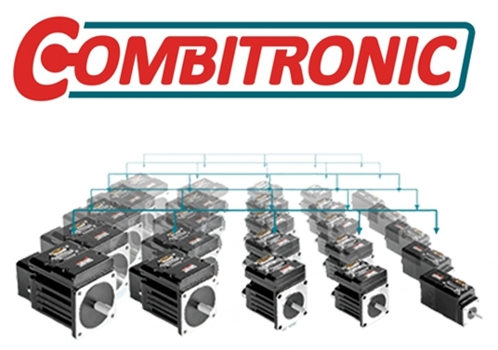
How Does Combitronic™ Work? (Example)
SmartMotor servos use a single letter G command to start a motion profile:
G 'Issue Go in local motor
Add Combitronic syntax to start one or all motors on the same network
G:2 'Combitronic Go to motor 2
G:0 'Combitronic global Go to all motors

Slide 19
Key Markets and Applications

Slide 20
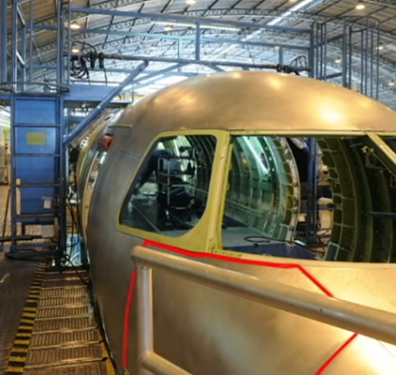
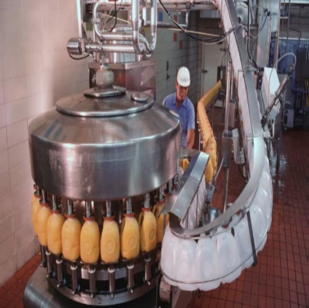
Simple Point-to-Point Positioning
Multi-axis Coordinated Motion
Entertainment
Vertical Applications
Sorting/Diverting/ Repositioning
Key Markets and Applications
Tracking, Pan and Tilt Systems
Bed of Nails, Arrays
Capping and Fastening
CNC Milling and Contouring
Welding

Slide 21
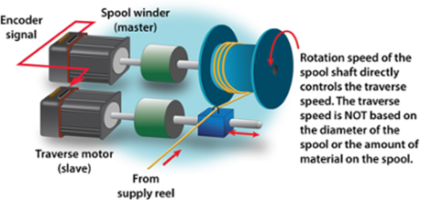
Example: Expanded Traverse/Takeup
Expanded Traverse and Takeup
Now supports complex winding patterns
Overlay camming profiles onto traversing profiles for complex patterns
Prevent material from becoming tangled or trapped when unwinding
Auto reverse and electronic gearing profiles for the perfect spool every time
The new Combitronic drive handles much larger spool motors for heavier loads
See website Case Studies and SmartMotor Developer’s Guide for details. Case Study: Traverse and Take-up for Winding Applications
Typical Setup Shown

Slide 22
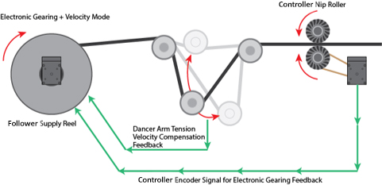
Example: Velocity Move and Gearing Summed Together
Electronic Gearing ensures instant response to controller nip roller speed
Velocity Mode is controlled by the tension arm
Assures constant tension over the change in supply reel radius
The Combitronic drive for supply reel, can support much heavier materials

Slide 23
Example: Large 4 Axis Gantry
An existing customer required higher load capacity on an X/X’, Y, Z gantry.
Combitronic drive provided code compatibility
Larger Moog CD motors powered the X and X’ axes
Integrated SmartMotors with simple daisy chain cables continue to reduce the weight of the Y and Z axes
Synchronized PTS( ) commands allowed multi-axis control of all motors from a single SmartMotor

Slide 24
Summary
Our SmartMotors are fully integrated into a compact unit that is easy to install and use
Integrating the Combitronic drive enables addition of higher torque servos to existing Smartmotor systems for large axes of motion
Combitronic technology ties together the processing power of the networked SmartMotors to give a full multi-axis system solution
Makes a difficult job easy!

Slide 25
Questions
&
Answers
Notes:
What makes SmartMotors different/better than other integrated servos on the market today?
How customizable are SmartMotors, can Animatics customize them for any application?
Can SmartMotors be used in a system that also has traditional “dumb” servos?
What kinds of tools and support does Animatics offer for application development using SmartMotors? Coding, on-site help, troubleshooting, etc.?
Can you describe an application that was very difficult or impossible to implement using traditional servos that was solved using SmartMotors?

Slide 26
Contact Us
Americas - West
Moog Animatics
2581 Leghorn Street
Mountain View, CA 94043
Phone: 650-960-4215
Americas - East
Moog Animatics
1995 NC Hwy 141
Murphy, NC 28906
Phone: 585-363-3125
Email: animatics_sales@moog.com
Website: www.animatics.com
Sales Support
RMA Support
Tech Support
Phone: 888-356-0357
Jackie Loredo
Phone: 650-960-4217
Email: JLoredo@moog.com
Kim Sandfort
Phone: 828-837-5115 x3573
Email: KSandfort@moog.com
Mary Monell
Phone: 585-363-3125
Email: MMonell@moog.com

